Slide 1
Data Science: Big Data Management Systems & Tools
Module 8: Data in Motion

Slide 2
Module 8 Summary
Data in Motion
Learning Outcomes
Define metadata, understand different types of metadata, and it’s importance;
Describe formats for serializing and transmitting data and their importance; and
Describe patterns of data transfer between one or more systems

Slide 3
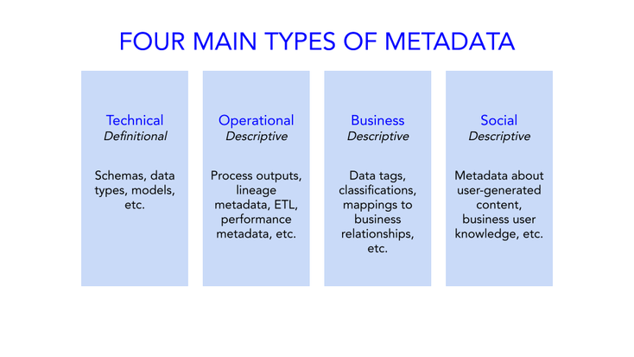
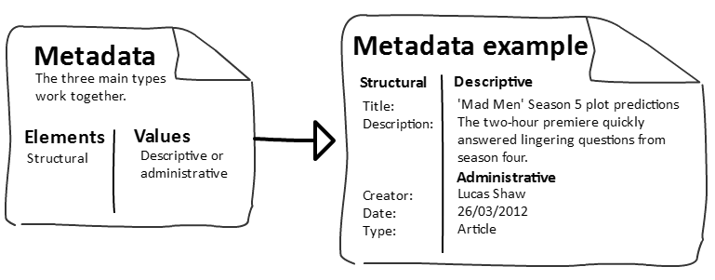
Metadata
“The data about the data”

Slide 4
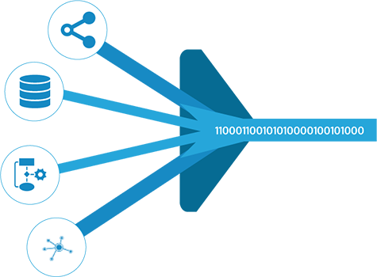
System Communication
How do different systems communicate and send messages to each other?
How can data move between systems?
What if they support different data types?
How will the destination system know what the incoming data looks like?
How do we coordinate the movement between systems?
How do we know the data arrived safely?

Slide 5
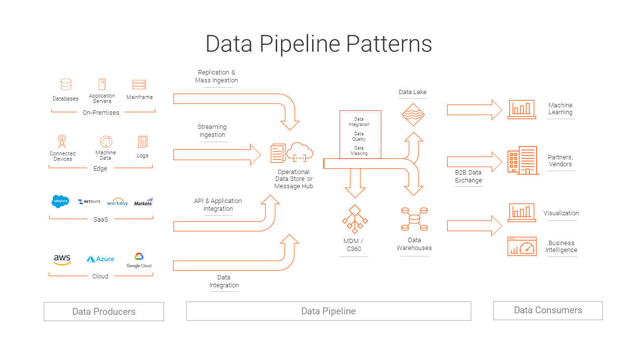

Slide 6
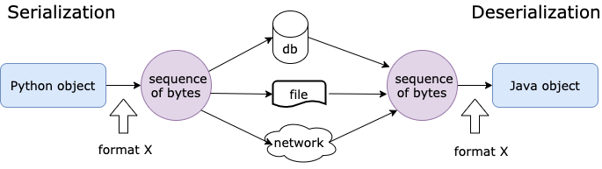
Data between applications
Scenario: We used a Python application to train a model. We need to store the trained model to disk so we can use it later for model scoring in a Java application.
Serialization: We need to convert the model object (Python object) to a sequence of bytes so we can store it in a file to disk. We will use metadata to keep information about the object’s original format.
Now the data is stored in a file on disk so we can access it later for model scoring
Deserialization: Now we’re ready to execute our Java application to score the model.
Note that there are standard tools that can be used for Serialization / Deserialization

Slide 7
Tools for Encoding / Decoding
Each language comes with their own packages for Serialization / Deserialization
e.g. Java’s Java.io.Serializable and Python’s Pickle
Problem is, you need to have those languages installed on the machines in order to use their serialization/deserialization capabilities and an object serialized in one language may not be deserializable in another
Instead, we can use a data format like XML, JSON, CSV that can be interpreted by any programming language and supported in most systems. This allows for portability of data between systems.

Slide 8
Message Passaging & Versioning
How is information passed between systems?
Flat file
Message = file or HTTP request
Message format: XML, JSON, CSV
Backward compatibility is a property of an application which allows it to be able to read data that was written previously by an older version of the application.
Forward compatibility is a property of an application which can read data written by a new version of the application.

Slide 9
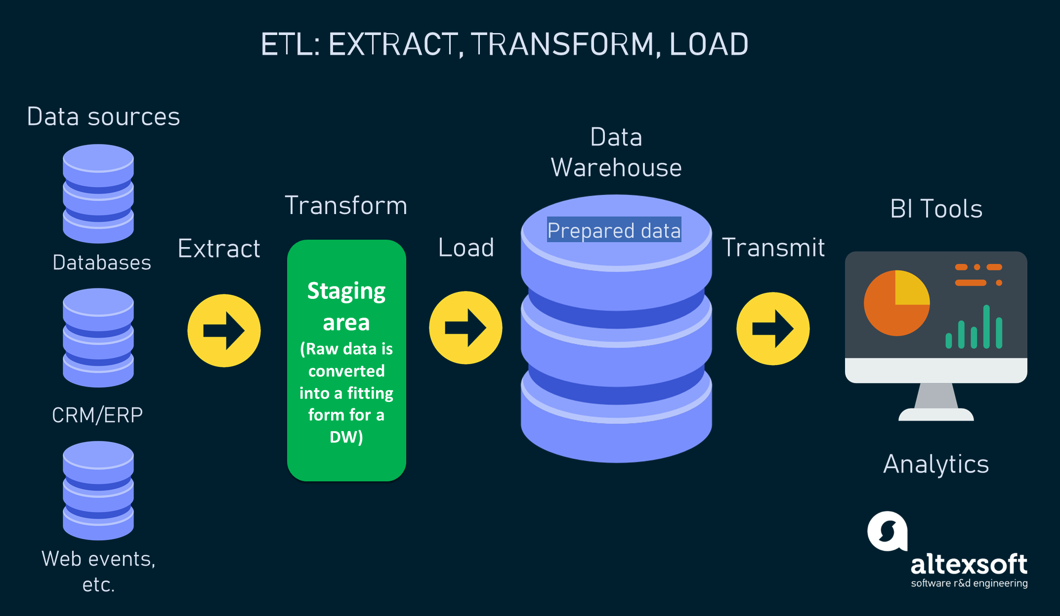
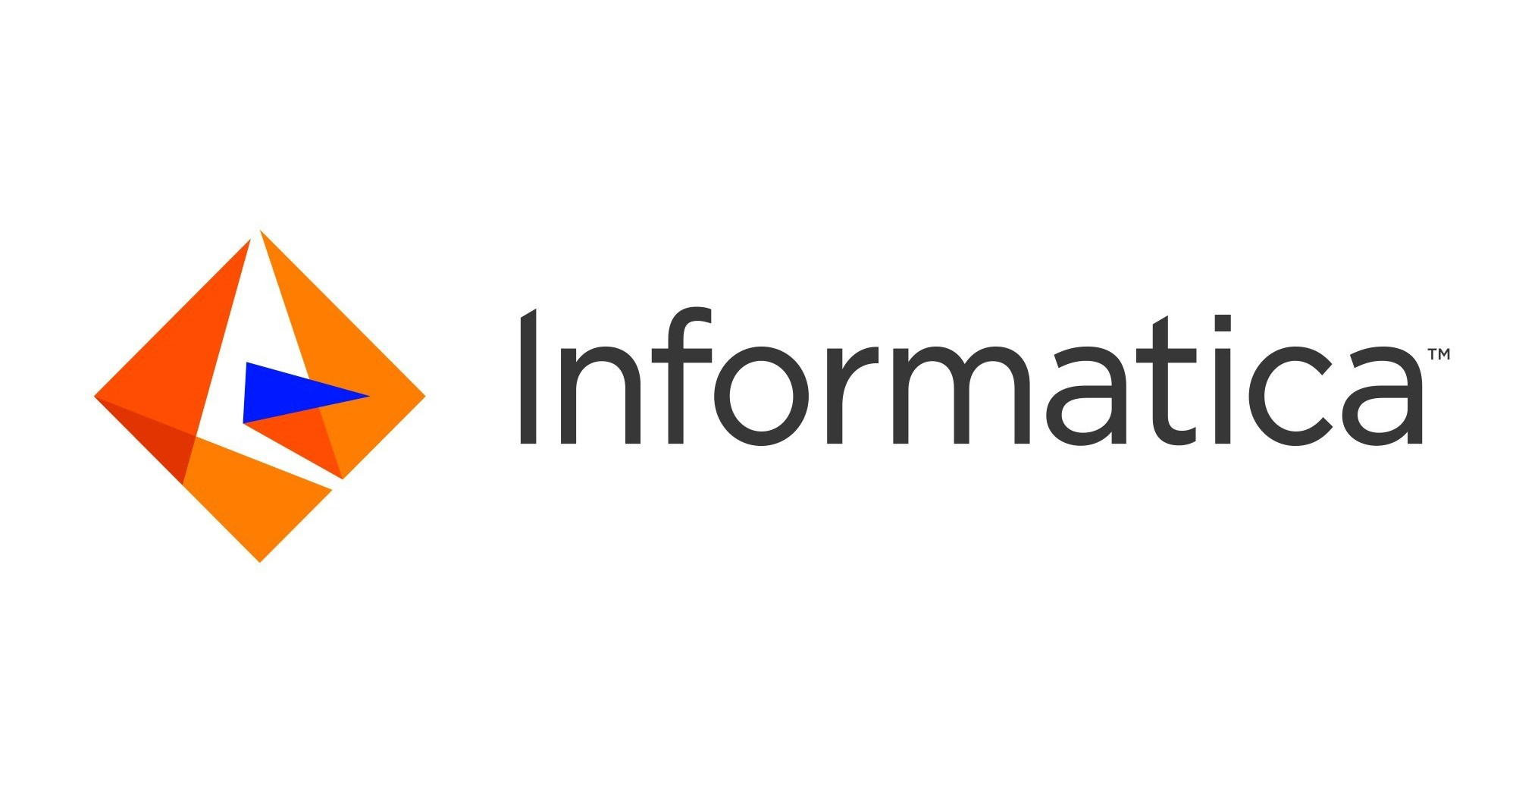
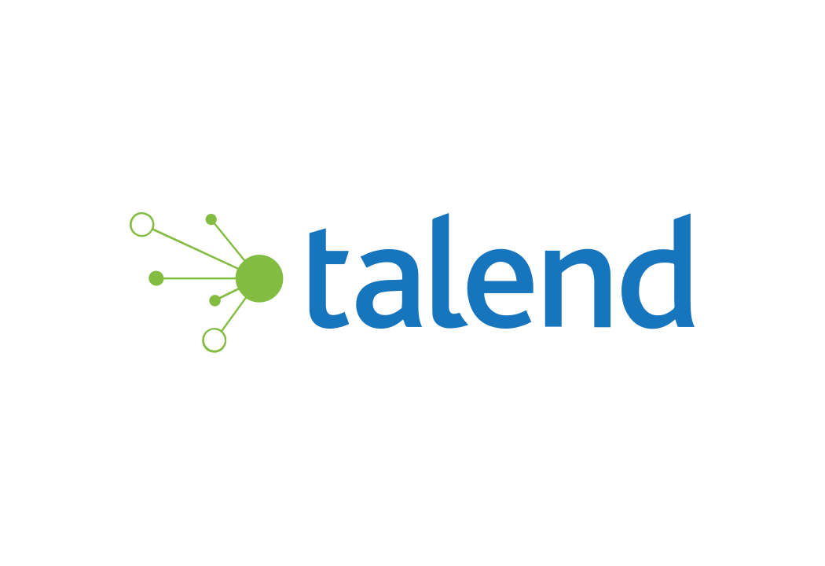
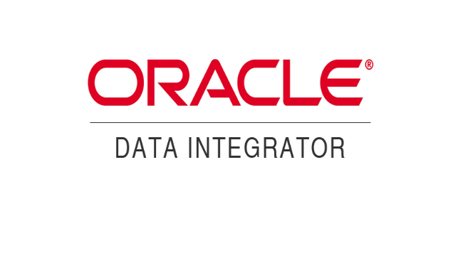
Data Integration - ETL
Source: https://www.google.com/url?sa=i&url=https%3A%2F%2Fwww.altexsoft.com%2Fblog%2Fetl-vs-elt%2F&psig=AOvVaw3wLClM_CX1est-S5gV9wwl&ust=1637965879763000&source=images&cd=vfe&ved=0CA0Q3YkBahcKEwjI5JHIyLT0AhUAAAAAHQAAAAAQAw

Slide 10
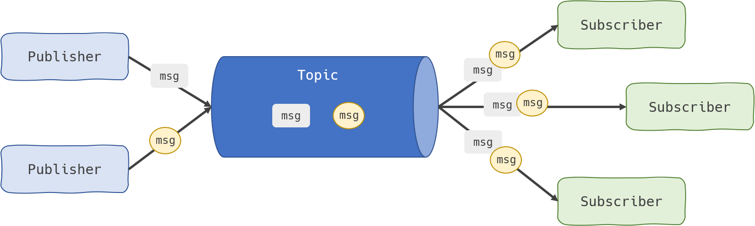

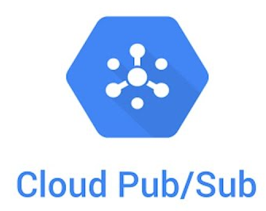
Data Integration - Publish & Subscribe
Source: https://www.google.com/url?sa=i&url=https%3A%2F%2Fdashbird.io%2Fknowledge-base%2Fwell-architected%2Fpub-sub-messaging%2F&psig=AOvVaw30MLHO79V42BhRkL7-NKmu&ust=1637966308117000&source=images&cd=vfe&ved=0CA0Q3YkBahcKEwiwovuZyrT0AhUAAAAAHQAAAAAQGA

Slide 11
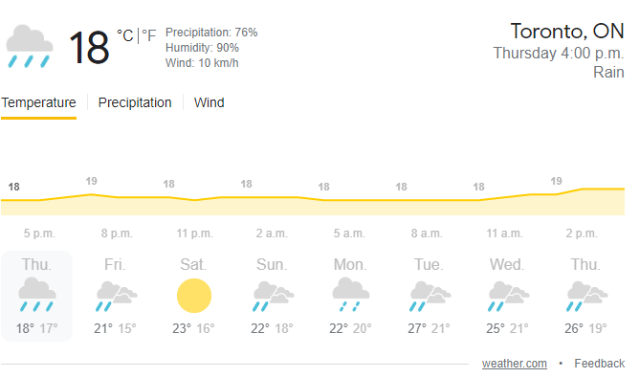
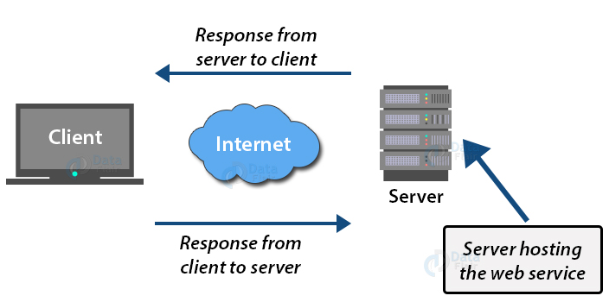
Service Oriented Architecture (SOA) & Web Services
SOA is an architectural style that is based on the idea that applications should be organized like a community of interacting service providers
Each application can speak to the other regardless of the language that was used to develop the application
The interacting application doesn’t need to know how the other works under the hood, just how to ask it for the information it needs
The interaction between the two systems is done through a web API (Application Programming Interface) call
Google doesn’t have it’s own weather data so it sources its information from a third party - The Weather Network.
It uses a weather API to execute an API call and collect the relevant information it needs.
Google’s application can then receive the data most likely as JSON file and render the data in the format they needed.
Google’s application has no idea what the weather API is doing to collect the data, it just knows how to leverage the Weather API that’s made available to them.

Slide 12
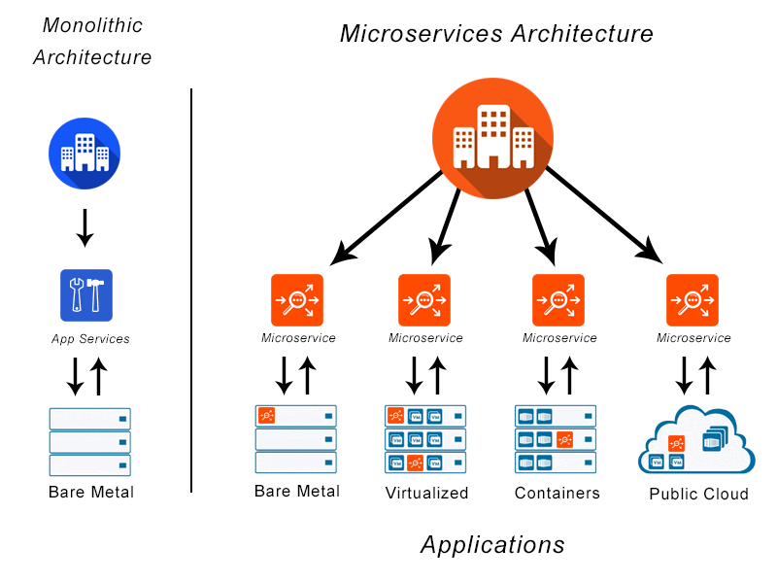
Microservices
Provides a way to isolate and decouple services into smaller, autonomous services
That way, each service can be updated without affecting the others (incurring downtime)
Characteristics:
Modeled after Business Domain
Embracing a culture of automation: automatic testing and continuous delivery
Hide implementation details: no direct access to databases
Decentralize all things: no broker needed between apps
Deploy independently
Consumer first: rich API documentation is critical
Isolate Failure: calls should have a time-out period with a message response to alert requestor of some failure
Highly Observable: provide ongoing stream of information about the services health and provide error alerts

Slide 13
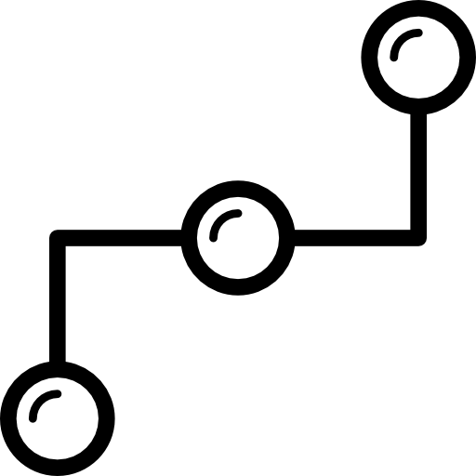
Why is this important?
Need to be able to connect data together from different systems for comprehensive analytics and agility in system maintenance

